Slide 1
Vanpool new driver orientation
Stress Less. Save Money.
Our mission is to provide and promote public transportation choices that support an accessible, sustainable, livable, healthy, prosperous community.

Slide 2
IMPORTANT REMINDER
You are not authorized to operate an Intercity Transit vanpool vehicle until WSTIP Defensive Driving for Vanpool Drivers is completed and you have met with a Vanpool staff member for Vanpool Orientation. Please contact us immediately with questions.

Slide 3
WELCOME!
This is the last step to being certified to operate our vans. Once you have completed the virtual orientation with a staff member at Intercity Transit, your fuel pin will be activated and you will be authorized to begin driving a vanpool vehicle with our agency.
This orientation meets best practices with Washington State Transit Insurance Pool (WSTIP).
Questions? Please email vanpool@intercitytransit.com or call
360-786-8800.

Slide 4
GETTING TO KNOW US
Lynne Cunningham, Vanpool Manager
Hauna Borja, Commuter Service Assistant
Magic Aguinaga, Vanpool Coordinator
Riley White, Vanpool Coordinator
Kyle McPherson, Vanpool Outreach Coordinator
Zach Heinemeyer, Vanpool Outreach Coordinator

Slide 5
HELPFUL OPERATIONS SUPPORT
Commuter Service Assistant
Schedule van pick up/drop off, maintenance and first-line for incoming phone calls and emails to our VP hotline inbox.
Vanpool Coordinator’s
Monthly report troubleshooting, individual and employer statements, payments/reconciling, event reports, inquiries/complaints, website/account maintenance and group route/roster changes.
Vanpool Outreach Coordinator’s
New riders/groups, employer outreach, community events, speaking and presentations, ETC support.

Slide 6
MONTHLY RIDERSHIP REPORT
If you are a new Group Leader or Reporter, your group will submit a ridership of attendance, along with the mileage of the van no later than the 3rd of each month. Delaying in reporting may pause your vanpool group and make your statements past due.
Please reference the Documents tab and select the “Vanpool Reporting Guide” for guidance.

Slide 7
Important group reminders
The Group Leader or Reporter is required to submit a monthly ridership report to us for each commute month. This information includes marketing ridership for each day, entering in mileage at the end of the month for your assigned van(s) during that month.
Monthly Report: Due no later than the 3rd of each month following the commute month.
Monthly Statements: Delivered to each commuter by the 6th of each month.
Monthly Payments: Paid in full by the 9th of each month.

Slide 8
VANPOOL ONLINE PROFILE ROLES
Group Leader – Primary to submit Monthly Ridership Report by the 3rd of each month.
Reporter – Backup to the Group Leader in their absence to submit Monthly Ridership Report by the 3rd of each month.
If your group is already in-service, these roles have already been assigned. If there are changes to these roles as a new driver, please contact us immediately.

Slide 9
NEW DRIVER RESPONSIBILITIES
Report any changes with your driving record to Intercity Transit Vanpool immediately.
Operate the van in a safe manner, to and from the worksite locations.
Communicate with your group and Group Leader when you will not be commuting, such as a vacation or other work obligations.
Document an additional trip outside of the regular commute.
Be a Defensive Driver!

Slide 10
SHARING keys and fuel card
Each driver in a group will share a set of keys issued. If you are new driver and need your own, please contact us.
Each van is assigned one WEX card to the group. Please use your individual fuel pin number/ID that you filled out for fuel or car washes.
You don’t need to print a receipt when using the WEX card.
You do need to print a receipt and record the mileage on the receipt if you use your own card for fuel or car washes. The receipt for verification should be sent to vanpool@intercitytransit.com

Slide 11
WHEN operating OUR VANS
Report all accidents or incidents immediately!
Accident? Call 911 first. Then contact Intercity Transit Dispatch (360-705-5890) and Intercity Transit Vanpool (360-786-8800).
Other incidents? Call 911 if needed. Then contact Intercity Transit Dispatch (360-705-5890) and Intercity Transit Vanpool (360-786-8800).
We will coordinate a tow-truck if needed, road-side assistance or our maintenance team anytime you contact us.
If you see something, say something. Do not attempt to fix or replace anything with the vehicle.

Slide 12
Vehicle insurance
As a Driver, you may show proof of insurance when requested by logging into your online commuter account and selecting the Documents tab, then selecting the WSTIP Insurance Card download link.
Your van be also include a hard copy in the glove box.
Please do not talk about the accident to a third party. All questions should be directed to our insurance provider, the Washington State Transit Insurance Pool (WSTIP) which is located on the back of the card.

Slide 13
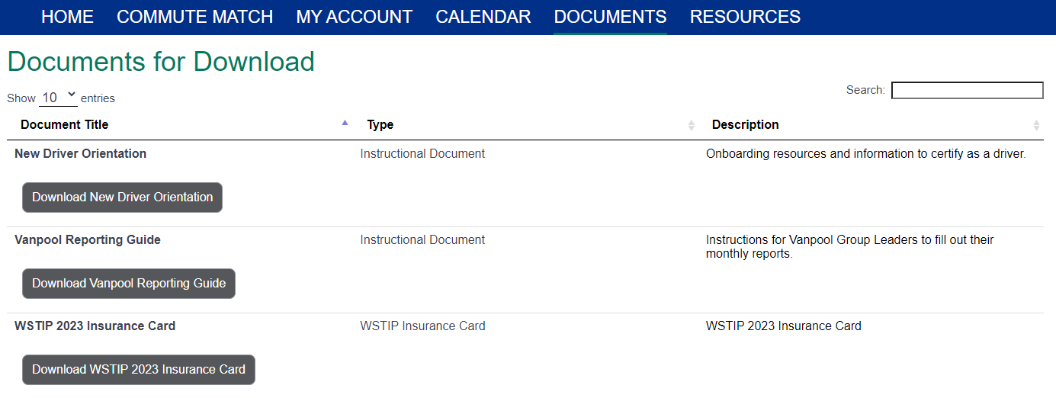

Slide 14
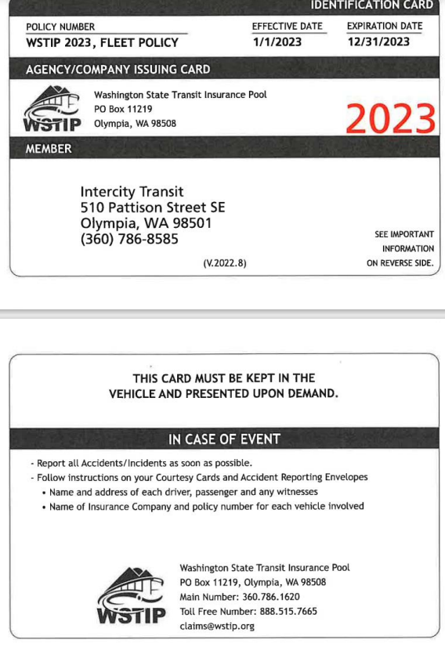

Slide 15
REPORTING AN ACCIDENT OR INDICIDENT
Being involved in an accident or incident can be stressful. Please report all accidents or incidents to us immediately.
The Group Leader will be contacted within 1 business day to assist us with completing a required Event Report (driver) and Courtesy Cards (riders). If you are the involved driver, we will contact you to collect the additional information on the Event Report.
Need a spare? We will work with your group depending on the reported accident or incident.

Slide 16
Van maintenance
All maintenance on your assigned van is done at 526 Pattison St. SE Olympia, WA 98501. Service is generally completed every 5,000 to 6,000 miles depending on the vehicle type or by time.
The Group Leader will be notified when the van is due for service.
Please do not show up without confirming your drop off day with our Vanpool team. Your group will be issued a spare.
Report all windshield cracks or dimples to us immediately before your van is due for service.
Report all vehicle concerns to your Group Leader who will contact us.

Slide 17
Dropping off a van for service
You will be contacted by phone or email from the Commuter Service Assistant. Upon arrival, proceed to the call box outside of gate and press the button for ‘Maintenance’ or call the shop at 360-705-5873 to tell them you are there for vanpool service. Maintenance staff will meet you outside the building and issue you a spare van.
Once you have parked next to the Vanpool door, text your van # and current mileage to 564-233-9442; do same for your spare van before leaving the lot.
Please keep all keys/fuel card to your regular van when you drop your van off for service.
Please always observe our lot speed limit of 7 MPH.
The maintenance shop is open 24 hours Monday-Thursday, 6am-midnight Friday-Sunday.

Slide 18
USING THE WEX CARD
Every van is assigned one WEX card to use for fuel and car washes. If your group is assigned a spare van, your group will also be using a spare WEX card. Your pin number remains the same and should not be shared with any other driver.
When stopping for gas, please insert the card and enter the current odometer, select the Enter button. The screen will then ask you to enter your current ID/pin number, then select Enter a second time and begin filling up.
All vans are unleaded only.
Forgot your pin? Contact us for assistance.

Slide 19
Need a new fuel card?
If your assigned WEX card is lost or stolen, the Group Leader should contact us immediately to have terminated and a new card will be mailed overnight to the Group Leader.
Have a smart device? Download the WEX Connect app and you can view all current fuel and car wash locations within 5, 10 or 25 miles of your current location.

Slide 20
Driving complaints
Intercity Transit takes driving complaints from the public seriously. Your defensive driving training course is valid for 5 years from the time of completion.
You represent Intercity Transit when driving our vehicle.
Watch your speed.
Follow all driving laws.
Do not text and drive or call and drive.
Do not park the van in unauthorized parking locations such as park and rides or store parking lots.

Slide 21
Other commute trips
As a certified driver, you are authorized for limited trips outside of the group route during or after your work commute. WSTIP does not cover “personal miles” rather trips as “incidental to the commute” such as a medical appointment trip or to the grocery store is authorized when the van is commuting that day.
The Group Leader or Reporter will need to document the trip on the Monthly Ridership Report. These miles are debited from the revenue miles. Discuss this with your group on ensuring accurate records.
Failing to report additional trips, means the Monthly Ridership Report may be denied for submittal and commuter Monthly Statements issued to the commuters may increase to a higher fare.

Slide 22
Inclement weather
Prepared for the winter weather? As a reminder, if road conditions are unsafe or members of your group are concerned about traveling, please do not operate the vanpool. Please err on the side of caution for the safety of your group and the van. We encourage you to plan ahead!

Slide 23
Vanpool incentives
First time joining the program get the 1st month fare FREE.
We appreciate you! Refer new riders and get $100 with your choice of Amazon gift card.
The new riders must rider at least one time within the first 45 days of being added to the group roster. The referral will be sent to your personal email address after 60 days. The referral will be voided if not meeting this requirement.
“3 is Enough” – just 3 people to start, you can have your own van and create your own schedule!

Slide 24
Thank you!
vanpool@intercitytransit.com
360-786-8800 (Monday-Friday 8:00-5:00)
360-705-5890 (After Hours/Emergencies)

